Slide 1
Technical Assistance
Please be aware that due to the demands of moderating the webinar we
are not able to respond to individual requests for technical support 30
minutes prior to and during the webinar presentation. If you experience
technical difficulties during this time, you can join us by teleconference.
Thank you!
Teleconference Line to listen:
Toll-free number: 1-888-453-4221
PARTICIPANT ACCESS CODE: 860544#
Notes:
Moderator

Slide 2
BEST Suite Success: Apps for Increasing Self-Regulation and Productivity at Home, School, & Work
Presented by:
Michelle Wild
November 1, 2017, 2:00 PM – 3:30 PM PST
This webinar training is provided by California Foundation for Independent Living Centers in partnership with the Department of Rehabilitation.
© 2017 – California Foundation for Independent Living Centers – All rights reserved
California Foundation for Independent Living Centers materials may be reproduced for non-commercial purposes provided their source is identified.

Slide 3
Webinar Logistics – Participant Features
Audio – USB Microphone Headset
(Tools>Audio>Audio Setup Wizard)
Raise Hand
Chat
Closed-Captioning or Ctrl + F8
Activity Window or Ctrl + Forward Slash
Polls
Notes:
Moderator

Slide 4
Teleconference Logistics
For those without access to a microphone and/or headset, the call in
information is:
Teleconference Line to listen:
Toll-free number: 1-888-453-4221
PARTICIPANT ACCESS CODE: 860544#
Before the webinar begins, please mute your line by pressing star (*) 6.
DO NOT put your line on hold, as it will create a background music.
During the Q&A, press star (*) 6 to unmute your line.
Notes:
Moderator

Slide 5
BEST Suite Success: Apps for Increasing Self-Regulation and Productivity at Home, School, & Work
Michelle Ranae Wild, M.A.
President/CEO
michelle@bestconnections.org
Kristi Pero
Curriculum Designer/Trainer
kristi@bestconnections.org

Slide 6
Disclosure
We are staff members of a nonprofit called BEST, which created the PaceMyDay and ReachMyGoals apps and provides online app training.

Slide 7
COGNITIVE ISSUES IMPACTING HOME, SCHOOL & WORK
Memory
Low energy
Problem-solving
Organization
Time-management
Poor insight

Slide 8
Making Cognitive Connections
Emphasizes the benefits of smartphone devices as memory/cognitive prosthetic devices.
Teaches the fundamental technical skills necessary to operate a smart device while simultaneously drawing a parallel to the cognitive skills that underlie the development of those technical skills.

Slide 9
BEST SUITE
PACEMYDAY
REACHMYGOALS
STRATEGIZEMYLIFE

Slide 10
BEST Apps
PaceMyDay
ReachMyGoals
Optimize
the energy you
have for success!
Set goals.
Monitor progress.
Build on successes.
Plan your day based on your sleep and how you feel so you set yourself up for success.
Identify the optimal amount of time in which you can do certain tasks and still have reserve energy.
Identify appropriate breaks to help re-energize you.
Set personalized, specific, measurable goals.
Break down the goals into tasks with due dates.
Receive reminders of due dates.
Identify self-goal-related challenges and successes.

Slide 11
BEST Suite: PaceMyDay
Energy management
Time management
Identify how long tasks take post-injury
Integrate breaks
Practice principles of self-regulation
BEST Suite available in App Store for $9.99
https://itunes.apple.com/us/app/best-suite/id1254448842?mt=8

Slide 12
BEST Suite: ReachMyGoals
Plan activities
Practice principles of self-regulation
Set goals
Party
School semester
Project
Establish task lists
BEST Suite available in App Store for $9.99
https://itunes.apple.com/us/app/best-suite/id1254448842?mt=8

Slide 13
BEST Practices in App Training
Step-by-step instructions with screen captures to help orient users to app screens
Review of training materials (written and videos) as often as needed to learn the apps
Learning to use apps independently, from user’s own computer
Notes:
EITHER this slide or the next one, not both

Slide 14
BEST Practices in App Training
Learning to troubleshoot problems before they happen
Practicing each skill learned by completing exercises, activities and projects
Integrated Making Cognitive Connections activities
Training environment that remembers where users left off
Notes:
EITHER this slide or the next one, not both

Slide 15
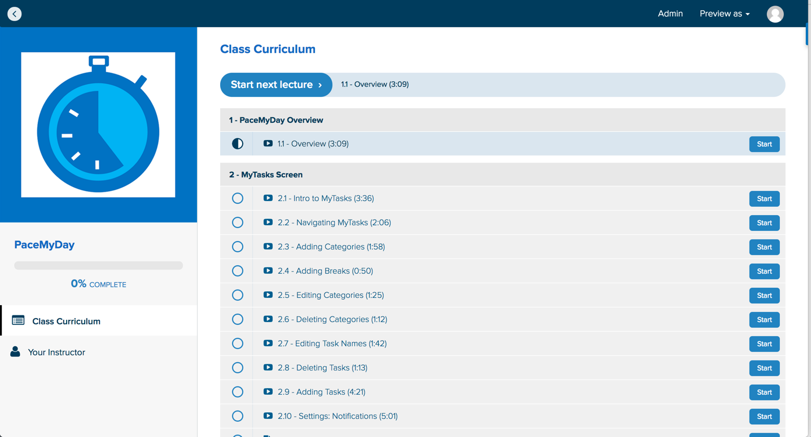
BEST Practices in App Training
Short video trainings
Screenshots and step-by-step instructions
Give It A Try exercises to provide practice in applying newly learned skills
Quizzes to help test app knowledge

Slide 16
BEST Practices in App Training
Troubleshooting scenarios integrating app-related problems with practical solutions
Putting it All Together projects to practice the integration of all features learned
Integration of Making Cognitive Connections to illustrate relevant cognitive rehabilitation applications

Slide 17
Michelle Ranae Wild
Brain Education Strategies and Technology Inc.
BESTconnections.org
michelle@bestconnections.org
949-310-3202

Slide 18
Recorded Webinar Training
This webinar training has been recorded. Please
allow 7-14 business days for the edited version to
be available and posted on our Website, Vimeo, and YouTube Channel.
You will receive an email with links to access the
recorded webinar training, presentation material,
and transcript.
Notes:
RP

Slide 19
THANK YOU!
This webinar training is provided by California Foundation for Independent Living Centers
in partnership with the Department of Rehabilitation.
© 2017 – California Foundation for Independent Living Centers – All rights reserved
California Foundation for Independent Living Centers materials may be reproduced for non-commercial purposes provided their source is identified.

